Slide 1
PROJECT TITLE
Date- 14th May 2025
PIP4004 University Project
Final Review-Viva Voice
“5G Network Traffic Prediction using Image and Text”
Batch Number: CST Grp-07
Roll Number | Student Name
20211CST0089 | Syed Fuzail
20211CST0113 | Syed Azam Hussain
20211CST0047 | Zubiya Sadaf
20211CST0093 | Asima Siddiqua
Under the Supervision of,
Prof. Lakshmisha S K
Professor
School of Computer Science & Engineering
Presidency University

Slide 2
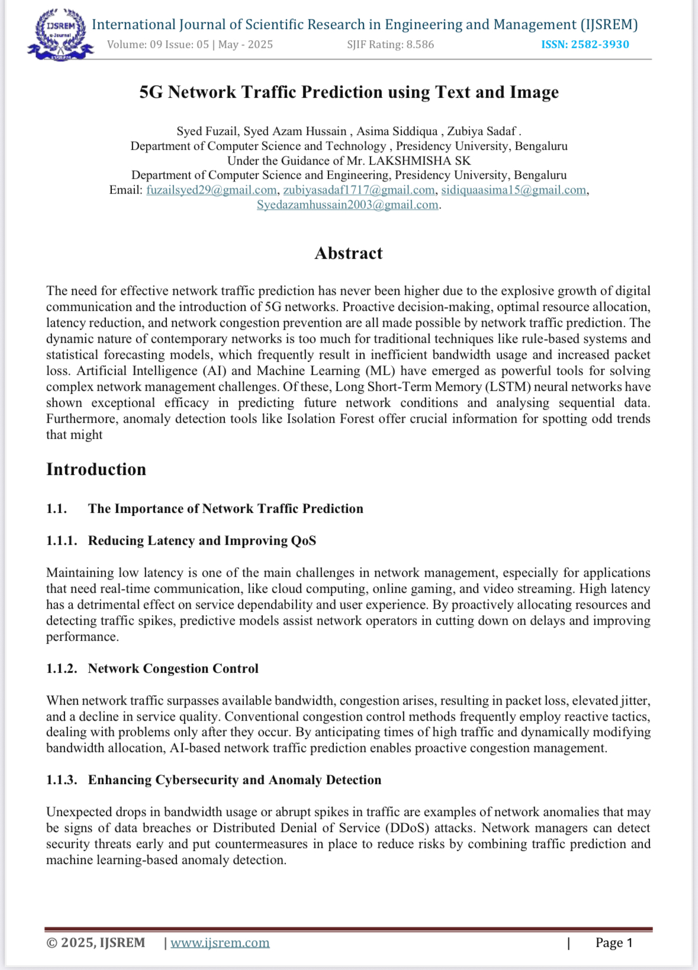

Slide 3
Introduction
Abstract Problem Statement:
5G networks are experiencing rapid growth due to increasing user density and diverse applications such as IoT, autonomous vehicles, video streaming, and online gaming. However, these networks face challenges in managing dynamic traffic variations, leading to congestion, increased latency, and reduced Quality of Service (QoS). Traditional traffic management methods rely on static rules and predefined thresholds, which struggle to adapt to real-time network fluctuations.
This project proposes an AI-based traffic prediction system to optimize 5G network performance. The system collects real-time network data, including latency, jitter, packet loss, and bandwidth usage. A machine learning model (Random Forest, LSTM, or CNN) is trained on historical and real-time traffic data to predict congestion patterns. Using AI-driven traffic optimization and Software-Defined Networking (SDN), the system dynamically allocates bandwidth and prioritizes critical data flows, preventing congestion before it occurs.
The proposed solution integrates a real-time monitoring dashboard using Flask/Django and Plotly to visualize network performance and congestion trends. Expected outcomes include improved network efficiency, reduced latency, and enhanced user experience. Future enhancements will focus on reinforcement learning for self-optimizing networks, edge computing integration, and AI-driven anomaly detection for security threats.

Slide 4
Literature Review
• Summary of Key Papers:
1. “AI-based Traffic Forecasting in 5G Network”
Authors: Mohseni et al. Findings: Utilization of 1D Convolutional Neural Networks (1D-CNN) for predicting 24-hour traffic patterns, demonstrating significant accuracy improvements.
2. “5G Traffic Prediction Based on Deep Learning”
Authors: Gao, Z. Findings: Development of a smoothed Long Short-Term Memory (SLSTM) model to address non-stationary traffic sequences, resulting in enhanced prediction accuracy.
3. “AI-Driven 5G Network Optimization: A Comprehensive Review”
Authors: Bikkasani, D.C.
Findings: Comprehensive review of AI-driven methods for 5G network optimization, focusing on resource allocation, traffic management, and dynamic network slicing.
4. “Deep Learning Based Traffic Prediction for Resource Allocation in Multi-Tenant Virtualized 5G Networks”
Authors: Rebari, P., & Killi, B.R.
Findings: Comparative analysis of deep learning models (LSTM, BiLSTM, Stacked LSTM, GRU) for traffic prediction and resource allocation, highlighting the superior performance of GRU models.

Slide 5
Literature Review
6. “Performance Enhancement of 5G Networks Using AI-Driven Techniques”
Authors: Chinda, F.E., Gin, W.A., & Okpor, J.
Findings: Exploration of AI-driven algorithms for optimizing resource allocation, predicting maintenance needs, and enhancing network efficiency in 5G networks.
7. “Realtime Mobile Bandwidth and Handoff Predictions in 4G/5G Networks”
Authors: Mei, L., Gou, J., Cai, Y., Cao, H., & Liu, Y.
Findings: Development of Recurrent Neural Network models for real-time bandwidth and handoff predictions, achieving over 80% accuracy in 4G/5G handoff scenarios.
8. “Mobility, Traffic, and Radio Channel Prediction: 5G and Beyond Applications”
Authors: Rydén, H., Palaios, A., Hévizi, L., Sandberg, D., & Kvernvik, T.
Findings: Overview of machine learning applications in mobility, traffic, and radio channel prediction, emphasizing their importance in future 5G and 6G networks.
9. “Cellular Traffic Prediction Using Online Prediction Algorithms”
Authors: Mehri, H., Chen, H., & Mehrpouyan, H.
Findings: Investigation of live prediction algorithms for real-time cellular network traffic forecasting, introducing the Fast LiveStream Prediction (FLSP) algorithm to enhance prediction accuracy and reduce processing load.
10. “5G Traffic Prediction with Time Series Analysis”
Authors: Nayak, N., & Singh, R.R.
Findings: Utilization of Long Short-Term Memory (LSTM) models for predicting packet arrival intensity and burst occurrences, aiding in efficient resource allocation.

Slide 6
Proposed Method
AI-Driven Traffic Prediction Model:
Train a machine learning model (Random Forest, LSTM, CNN) on real-time and historical network traffic data.
Extract key features (latency, jitter, packet loss, bandwidth usage).
Predict network congestion and dynamically allocate resources.
Traffic Optimization Using AI:
Implement predictive load balancing using Software-Defined Networking (SDN).
Dynamically adjust bandwidth allocation based on predicted congestion.
Prioritize critical data (e.g., emergency services, video streaming).
Real-Time Monitoring & Visualization:
Develop a dashboard using Flask/Django + Matplotlib/Plotly to visualize traffic patterns, congestion levels, and network performance.

Slide 7
System Architecture
AI-Based Traffic Prediction for 5G Networks - System Architecture
1. Data Collection Module
• Sources:
• Open5GS (5G Core): Simulates 5G network traffic
• Wireshark: Captures real-time packet data
• Mininet (SDN Simulation): Emulates network topology
• Collected Data: Latency, jitter, packet loss, bandwidth usage
⬇ (Data flows to Preprocessing & Feature Engineering) 2. Preprocessing & Feature Engineering
Tasks:
• Data cleaning & normalization
• Feature extraction (latency, bandwidth, congestion level)
• Outlier detection & removal
⬇ (Processed data is sent to the Machine Learning Model)

Slide 8
System Architecture
3. Machine Learning Model
Model Choices:
• LSTM (Long Short-Term Memory): For time-series prediction
• CNN (Convolutional Neural Network): For pattern recognition
• Random Forest: For decision-based congestion classification
Outputs:
• Predicted congestion probability
• Estimated severity level
⬇ (Predictions are sent to the Traffic Optimization Module)
4. Traffic Optimization Module
• AI-Driven Adjustments:
• Dynamic Bandwidth Allocation: Reallocates network resources
• Predictive Load Balancing: Uses SDN controllers to reroute traffic
• Critical Traffic Prioritization: Ensures emergency & high-priority data flows smoothly

Slide 9
System Architecture
⬇ (Optimized network status is sent to the Visualization Module)
5. Visualization & Monitoring
Dashboard Built Using:
• Flask/Django (Backend)
• Matplotlib/Plotly (Graphs & Heatmaps)
Displayed Metrics:
• Real-time traffic patterns
• Predicted congestion alerts
• QoS performance statistics

Slide 10
Objectives
Primary Goal: Develop a machine learning model capable of accurately predicting network congestion in 5G networks.
Specific Objectives:
• Analyze real-time network data to identify patterns indicative of potential congestion.
• Implement AI-driven traffic routing mechanisms to dynamically optimize network resource allocation.
• Enhance overall Quality of Service (QoS) by reducing latency and jitter through proactive traffic management.
Network balancing with different Data.

Slide 11
Existing Methods and Their Drawbacks
Existing Methods
• Traditional Traffic Management Systems:
• Approach: Utilize static rules and predefined thresholds to manage network traffic.
Drawbacks:
• Inability to adapt to rapid and unpredictable traffic fluctuations inherent in 5G environments

Slide 12
Modules and Software Requirements
Modules
1. Data Collection Module:
• Collects real-time 5G network traffic data using Open5GS (5G core) and Wireshark (packet sniffing).
2. Preprocessing & Feature Engineering:
• Extracts key traffic metrics and normalizes data for training.
3. Machine Learning Model:
• Trains LSTM/CNN/Random Forest on network data to predict congestion.
4. Traffic Optimization Module:
• Uses AI for predictive load balancing and dynamic bandwidth allocation.
5. Visualization & Monitoring:
• Real-time dashboard for network traffic insights.

Slide 13
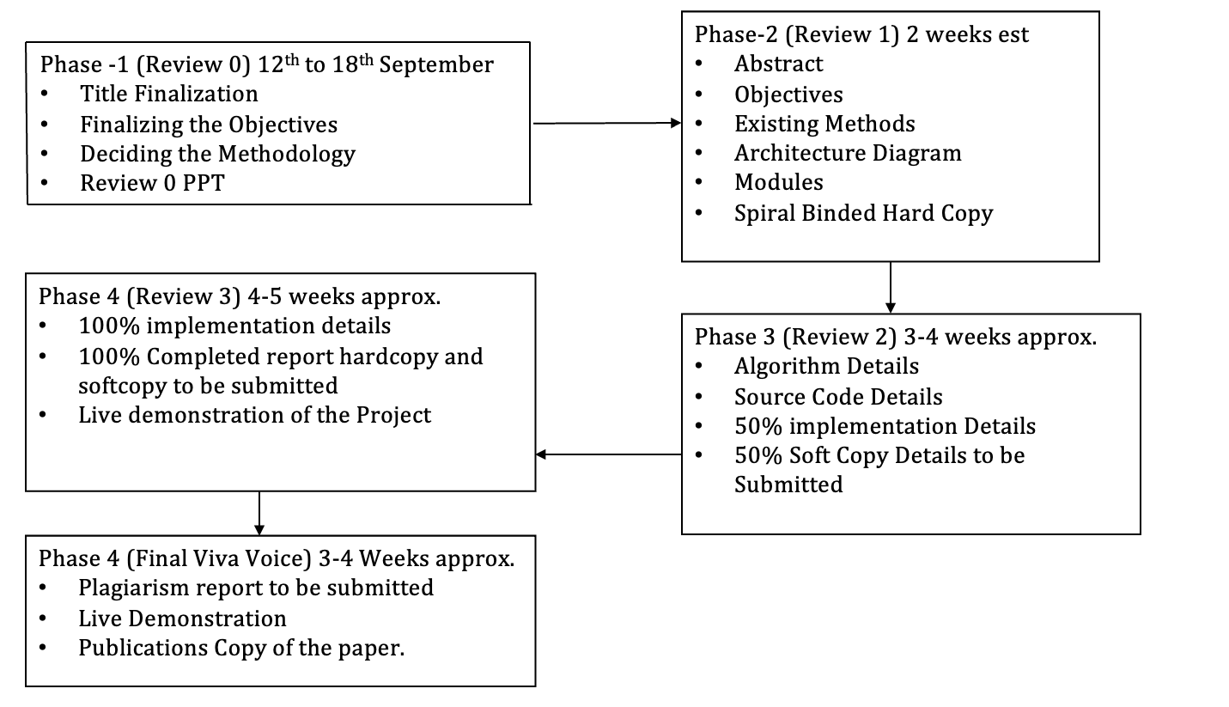
Timeline of Project

Slide 14
Expected Outcomes
1. Accurate Congestion Prediction:
• AI models (LSTM, CNN, or Random Forest) will predict network congestion with high accuracy, allowing proactive traffic management.
2. Dynamic Traffic Optimization:
• AI-driven load balancing and Software-Defined Networking (SDN) will ensure efficient bandwidth allocation, reducing congestion before it impacts users.
3. Reduced Latency & Jitter:
• Intelligent traffic management will minimize network delays, improving real-time applications like video streaming, gaming, and IoT communication.

Slide 15
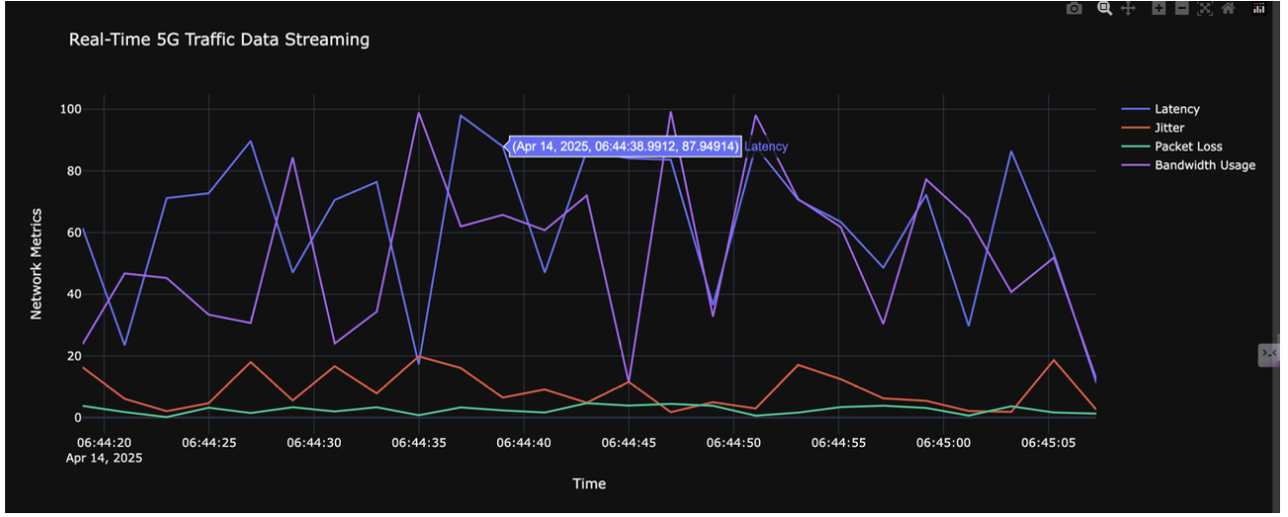
Results
Real time 5G Data Streaming at Intervals

Slide 16
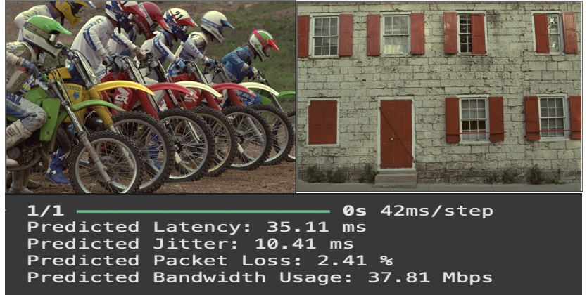
Real time image Data Prediction using Kodak Data Set

Slide 17
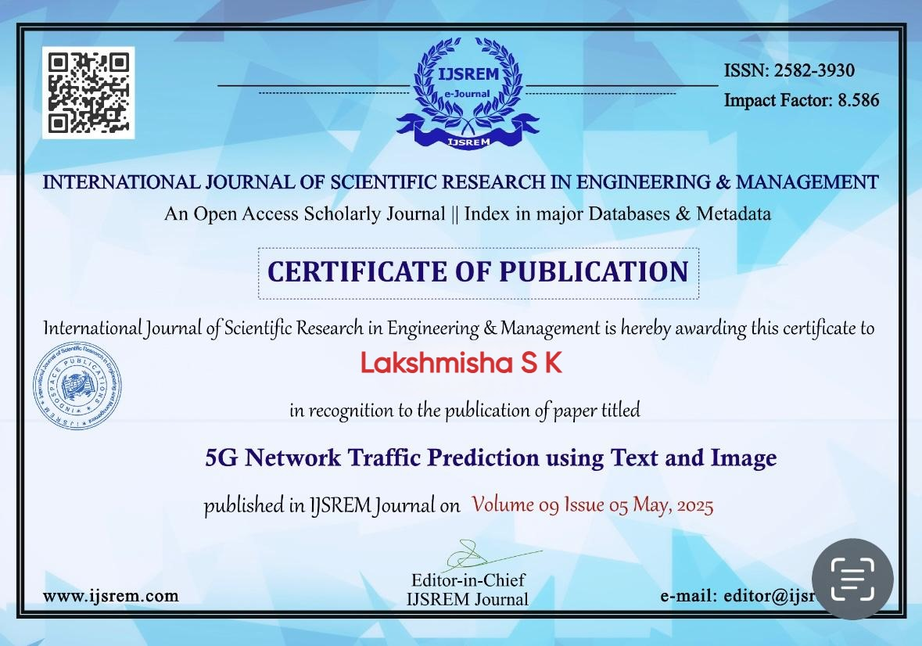
Paper and Acceptance

Slide 18
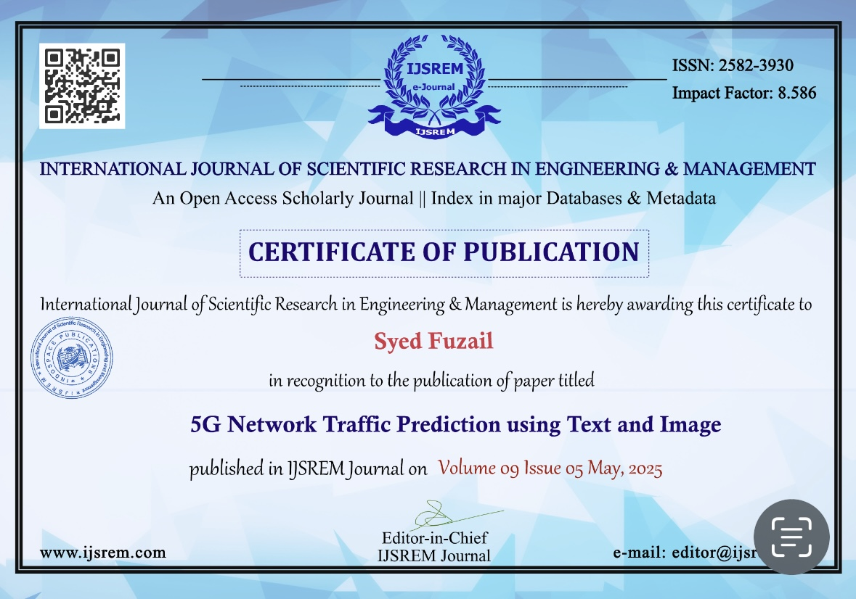

Slide 19
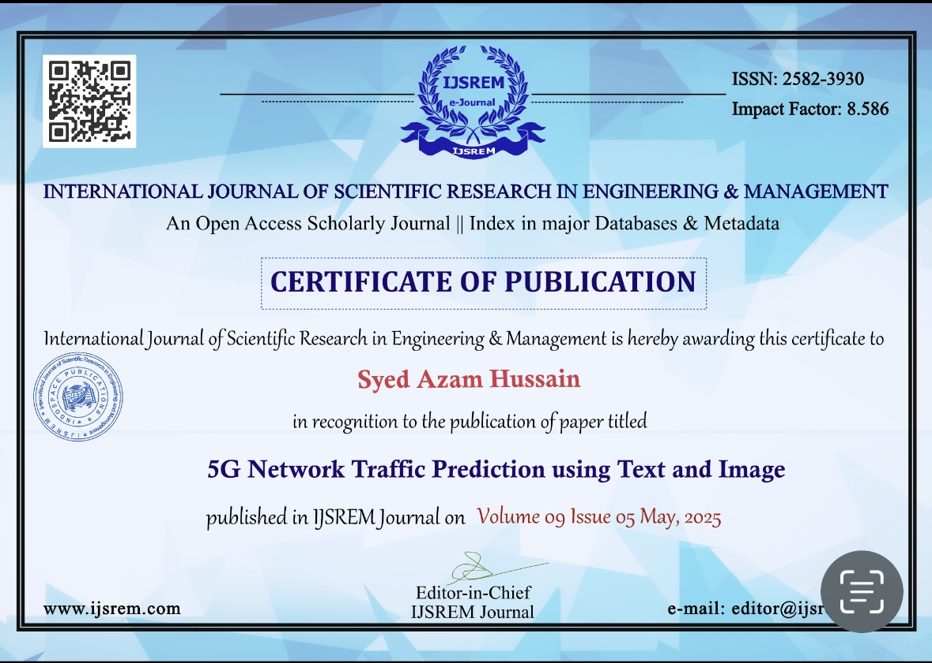

Slide 20
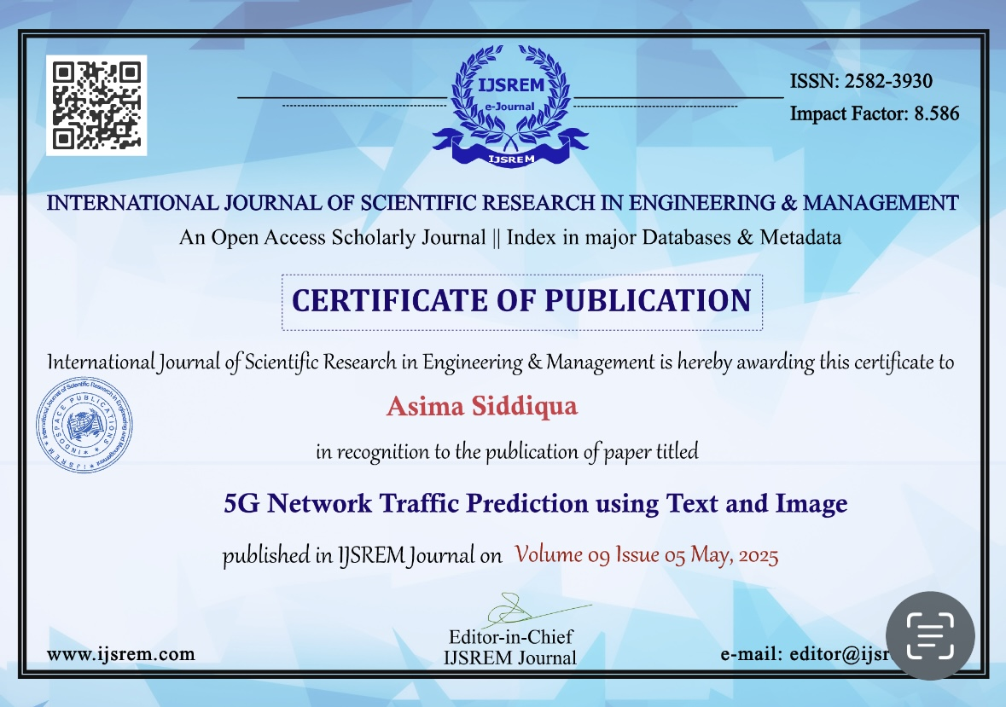

Slide 21
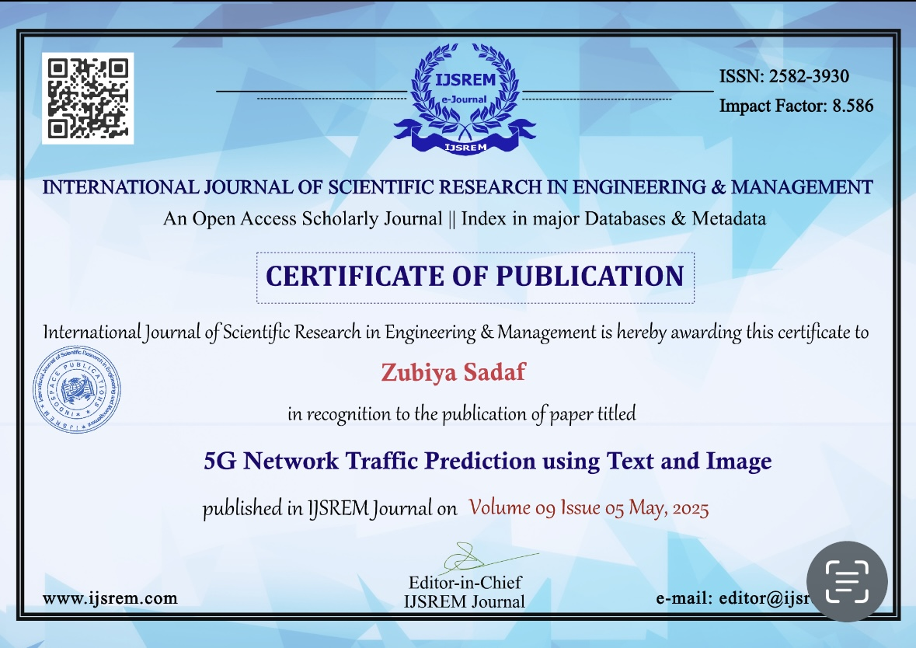

Slide 22
References
1. “AI-Based Traffic Forecasting in 5G Network”
Authors: Mohseni et al.
Summary: This study explores deep learning models, including 1D-CNN, for predicting 24-hour cellular traffic patterns, demonstrating significant accuracy improvements.
Link: https://ieeexplore.ieee.org/document/9918226/
2. “5G Traffic Prediction Based on Deep Learning”
Authors: Gao, Z.
Summary: The paper introduces a smoothed Long Short-Term Memory (SLSTM) model to address non-stationary traffic sequences in 5G networks, enhancing prediction accuracy.
Link: https://www.ncbi.nlm.nih.gov/pmc/articles/PMC9249458/
3. “Long Term 5G Network Traffic Forecasting via Modeling Non-Stationarity”
Authors: [Authors’ Names]
Summary: This research presents the ‘Diviner’ deep learning model, designed to handle non-stationarity in long-term time series prediction, improving forecasting reliability in 5G networks.
Link: https://www.nature.com/articles/s44172-023-00081-4
4. “AI-Driven 5G Network Optimization: A Comprehensive Review”
Authors: Bikkasani, D.C.
Summary: This comprehensive review discusses AI-driven methods for optimizing 5G networks, focusing on resource allocation, traffic management, and dynamic network slicing.
Link: https://www.preprints.org/manuscript/202410.2084/v1

Slide 23
Thank You

